Slide 1
WEB 322 WEB PROGRAMMING TOOLS AND FRAMEWORKS
WEEK 2 - LECTURE 1
INTRODUCTION TO NODE.JS AND EXPRESS

Slide 2

What is JavaScript? Quick Review
JavaScript is a programming language.
High-level language.
It is a loosely-typed language.
Today, it is one of the most used and most learned programming languages in the world.

Slide 3

What can you do with JavaScript?

Slide 4

JavaScript in the Past
Initially, JavaScript was used to add interactivity to a web page.
Was referred to, by many, as a “toy” language.
Required a browser to run using a JavaScript engine (a component) of the browser.
Often referred to as a “Client-Side language” because it was executed within the browser (client) and not server, thus limiting its capabilities.

Slide 5

JavaScript Today
In modern development, JavaScript can build:
Web Apps
Mobile Apps
Real-Time Networking Apps (like chat apps)
Games

Slide 6
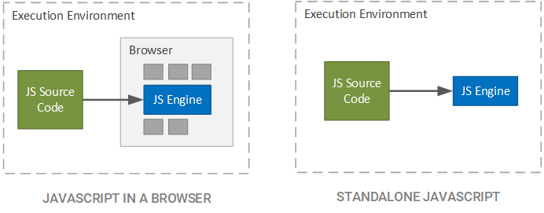
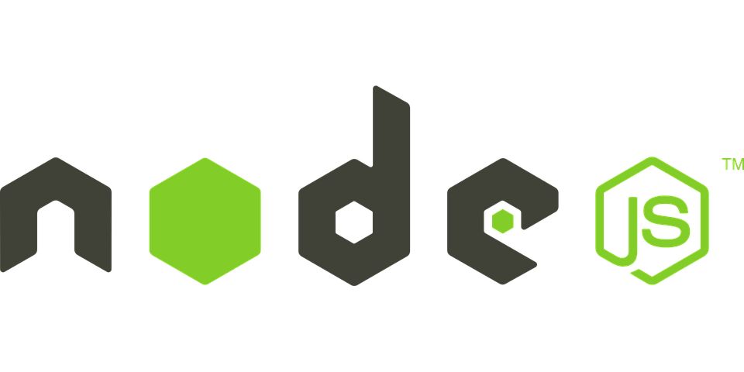

Where does JavaScript code run?

Slide 7
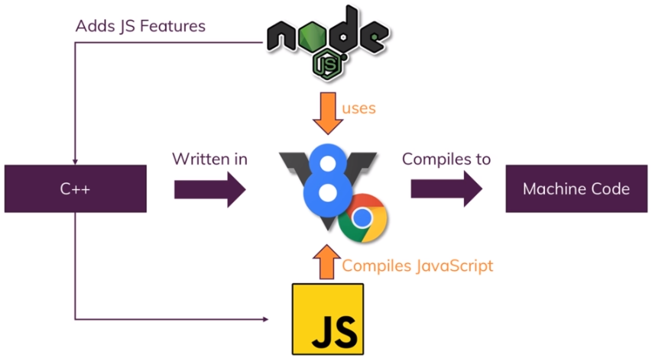
What is Node.js
A command-line JavaScript runtime (written in C++).
Allows you to run JavaScript outside of a browser. On your machine and/or a server.
Released in 2009, it uses the Chrome V8 JavaScript engine.
Adds additional capabilities to JavaScript, beyond what traditional JavaScript can do.
It supports asynchronous programming.

Slide 8
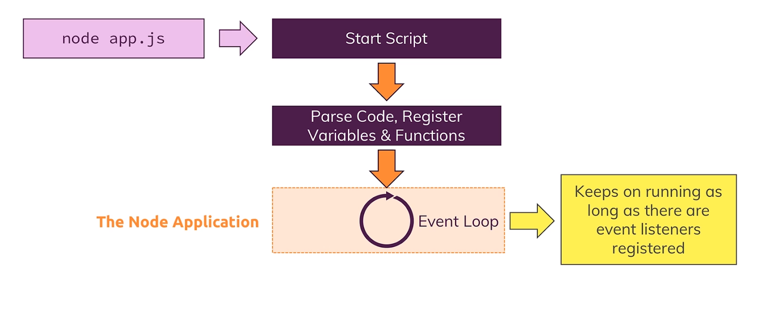
Node.js Lifecycle and the Event Loop

Slide 9

Node.js is not …
A programming language.
A server-side scripting language.

Slide 10
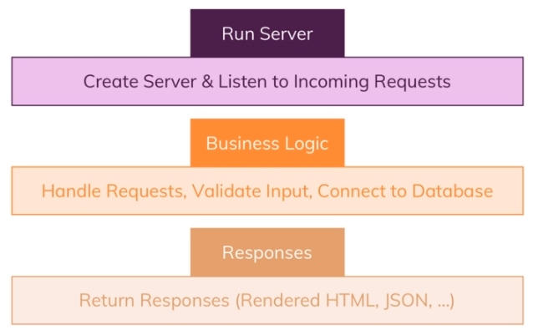
Roles of Node.js / What can we do with it?
Create powerful web servers:
Listen to incoming HTTP Requests.
Handle HTTP requests for a given web application.
Collect and validate form data.
Return responses to client.
Work with Databases:
Connect to databases.
Add, delete, modify data in your database.
Generate dynamic page content.

Slide 11
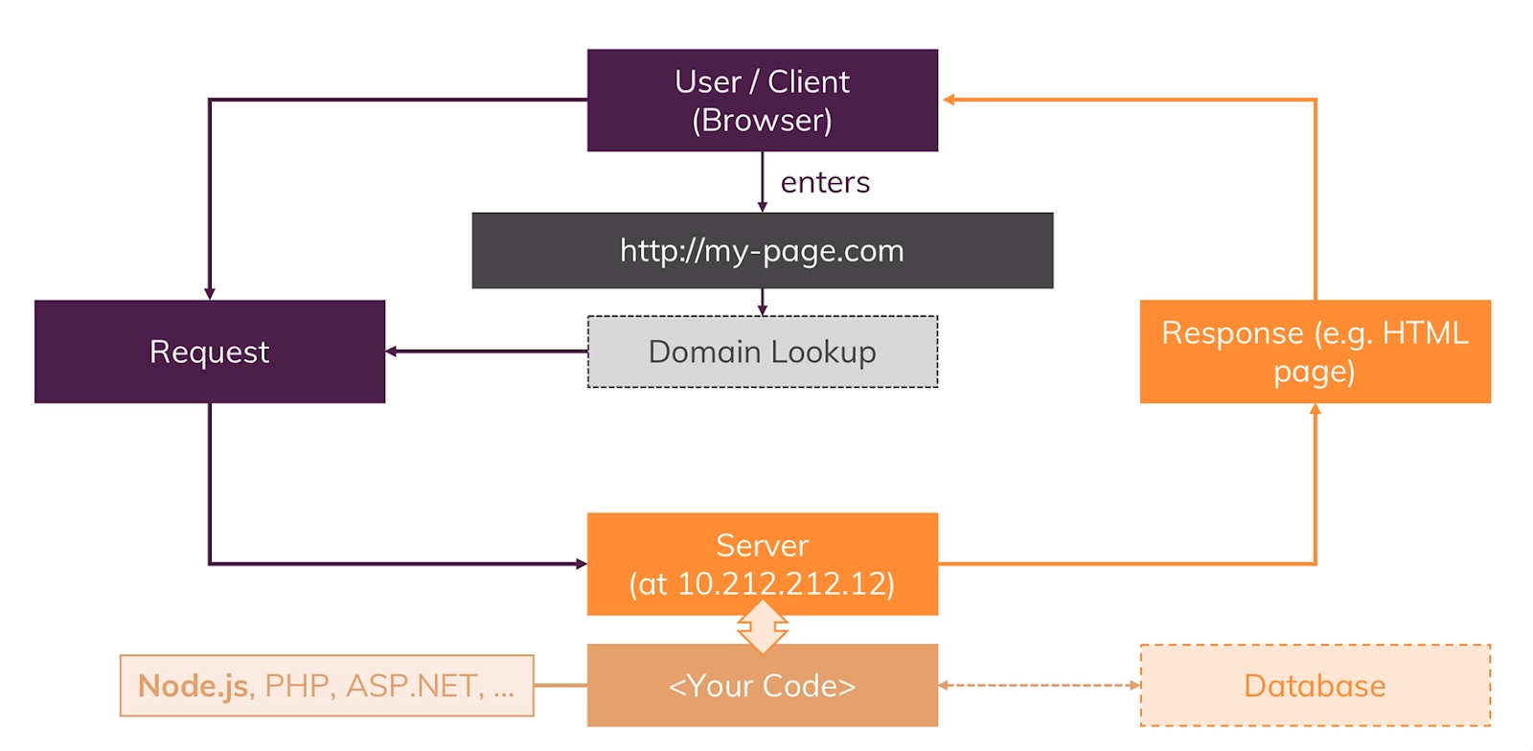
How do Server-Based Web Apps Work?

Slide 12

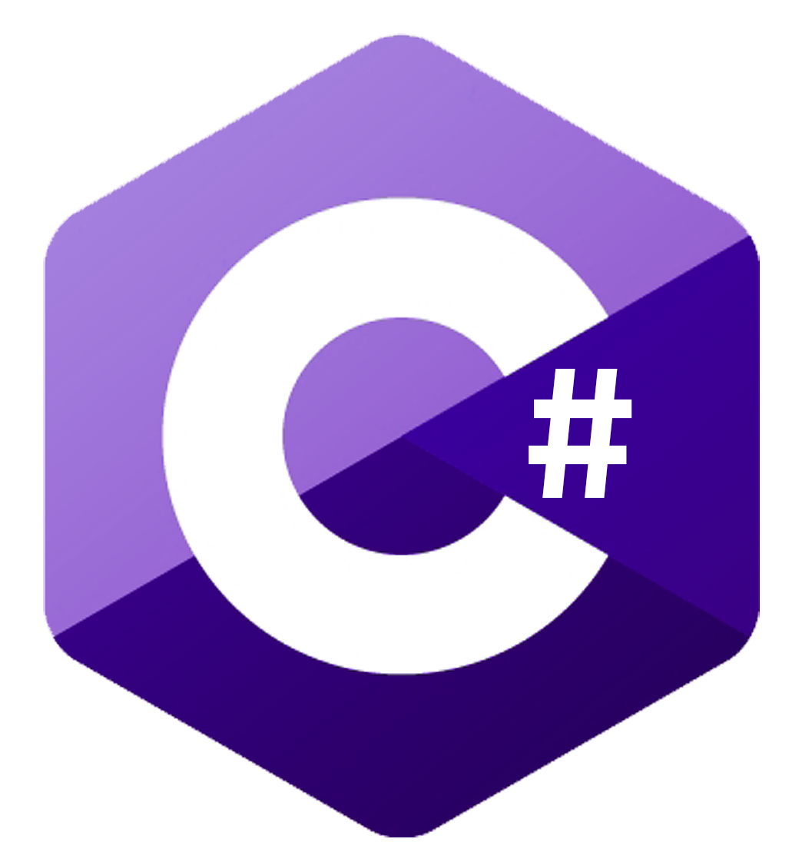



Alternatives to Node.js

Slide 13
Why choose Node.js?
There are many alternatives: python, java, php, ruby, C#.
Advantages
You only need to learn one language.
Use JavaScript to code both the Front-End and Back-End of a web application.
It supports Asynchronous programming and non-blocking code.
Great performance / fast execution.
Code sharing and reuse.
Trendy and high demand, many jobs on the market.

Slide 14
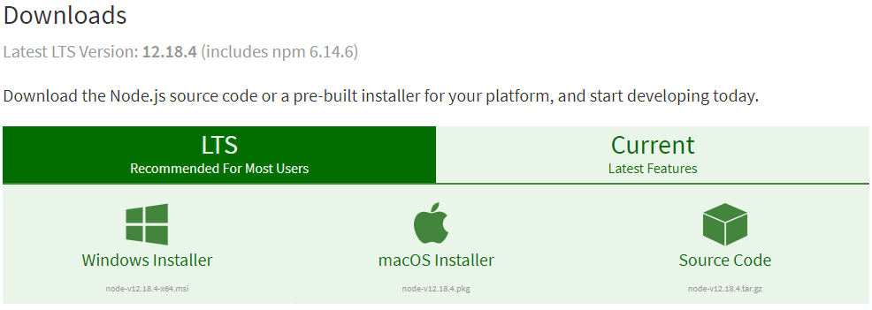
How to Install Node.js
Download Node.js: https://nodejs.org/en/download/
When you install Node on your machine, NPM is also installed.

Slide 15
Global Objects / Variables
In Node.js, you have access to various global objects and variables.
Console
Debugging console
Process
Provides information about the current Node.js process.
Exposes properties, methods and events for controlling system interactions.
_dirname
The name of the directory executing script resides in.
_filename
The executing file name.

Slide 16
More Global Objects / Variables
setTimeout()
Execute a piece of code after a certain delay.
setInterval()
Execute a piece of code repeatedly, after a certain delay.
Require()
Easiest way to include modules (contained in seperate files).
Reads a JavaScript file, executes the file, then returns the “exported” objects.

Slide 17
Included Modules
readline
Input and output mechanism.
util
Helper utility module used to support he Node.js internals.
Also contains useful functions for programmers such as formatting, encoding and decoding, and more.
path
Utilities for working with file and folder paths.
events
Register event listeners, act on events and emit events.

Slide 18
More Modules
fs
Working with the file system to read and write files.
Supports asynchronous operation to avoid blocking.
url
Methods for parsing and working with a url.
queryString
Methods for parsing and working with the query string part of a url.
Conversion between query string and object (key value pairs).

Slide 19

Node Package Manager (NPM)
Installed by default when you install Node.js.
Allows creation of reusable modules shared with the community.
Download modules and use them in your projects.
Command-line tool: npm
Global Modules
Installed like a command-line application on your computer.
Not for use in your own application.
Example, tools that can be used for your development.
Do not install into your node_modules folder.

Slide 20
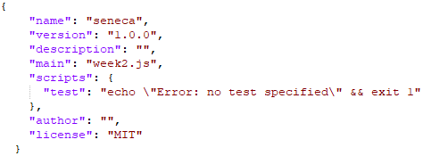
package.json
A listing of all the packages your application requires.
Contains version information for each package.
Run npm init to create an empty package.json file.
Add packages by running npm install.

Slide 21


